Slide 1
FRANCE
France, the largest country in Western Europe, is bordered by Belgium, Luxembourg, Germany, Switzerland, Italy, Spain, and Andorra. The population of France is approximately 66 million people. Its borders are punctuated by beautiful coastland with the Atlantic Ocean to the west, the Mediterranean Sea to the south, and two mountain ranges, the Alps and the Pyrenees. France is famous for a rich history, food, and culture. The climate of France, marine west coast and Mediterranean, is similar to western Oregon and southern California.

Slide 2
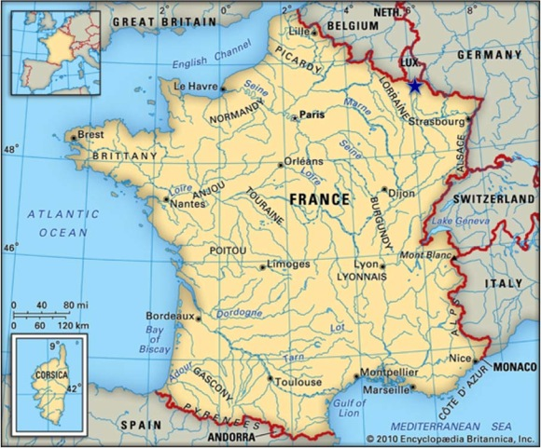
FRANCE

Slide 3
Capital: Paris, with 2.2 million inhabitants
Government: Democracy

Slide 4
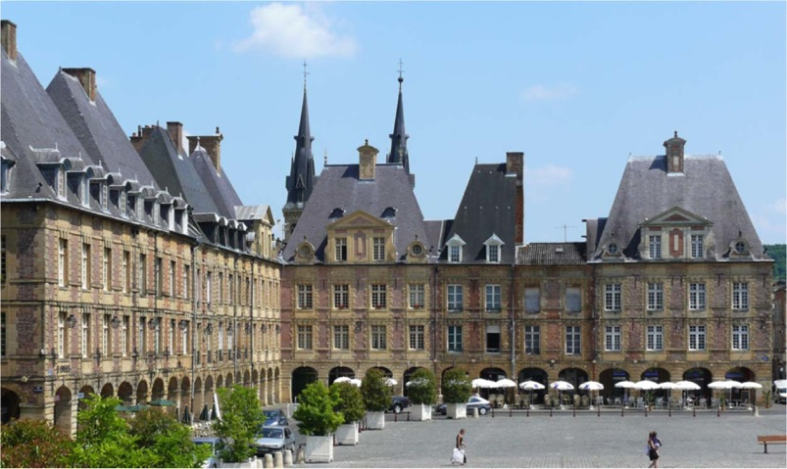
FRANCE

