Slide 1
GREECE
Greece, which has a population of 11 million, is famous as the birthplace of democracy and western philosophy. Home to some of the greatest architecture of the ancient world, including the Parthenon, ancient Greece was also a center for philosophy, science, and art. In addition to its large mainland mass, Greece is composed of 2,000 islands, which accounts for the fact that it has a strong culture of seafaring and fishing. The Mediterranean, Ionian, and Aegean Seas surround this beautiful country. Greece shares land borders with Albania, Macedonia (FYROM), Bulgaria, and Turkey. Its climate, Mediterranean, is similar to southern California.
People travel to North Greece to visit something that sits atop sheer sandstone pinnacles. What do they visit?

Slide 2
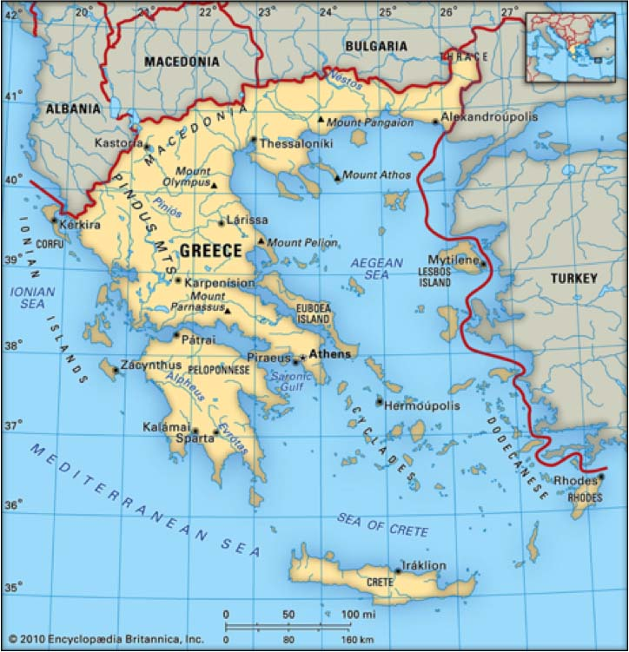
GREECE

Slide 3
GREECE
The official name of Greece is the Hellenic Republic.
The capital and largest city in Greece is Athens. Other major cities include Thessaloniki, Patras and Heraklion.
____________is the official language spoken in Greece

Slide 4
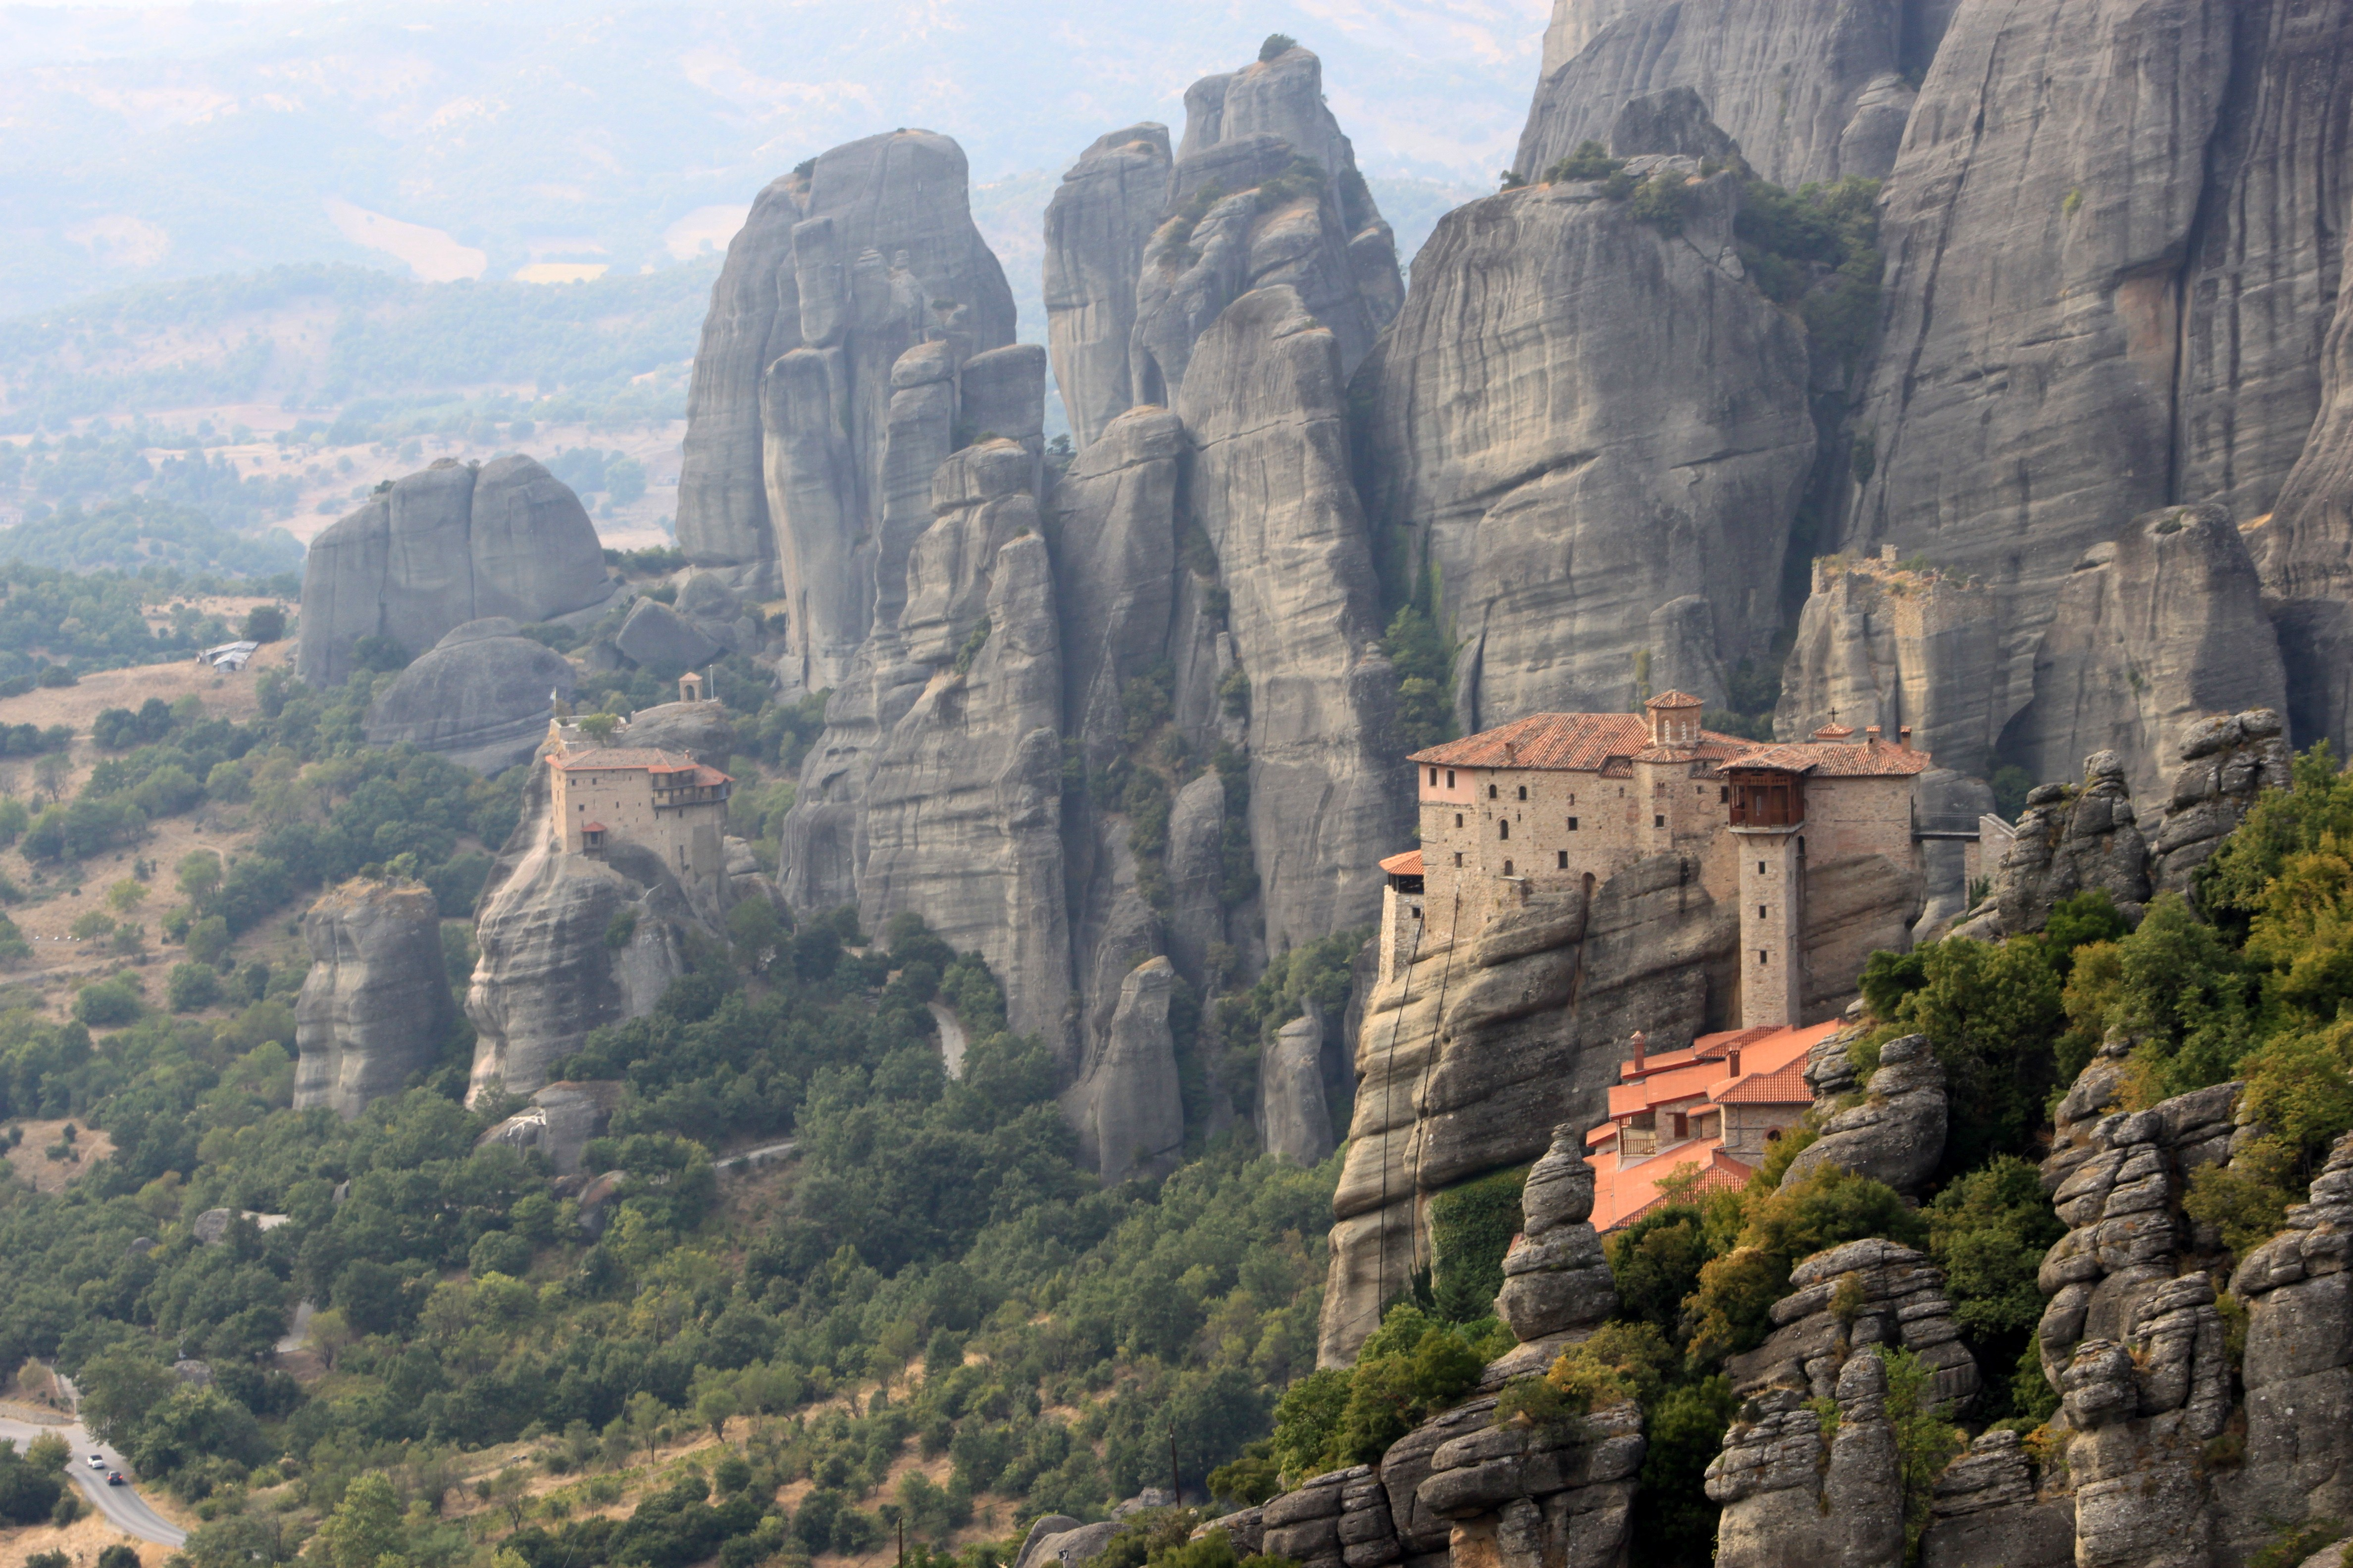
GREECE

Slide 5
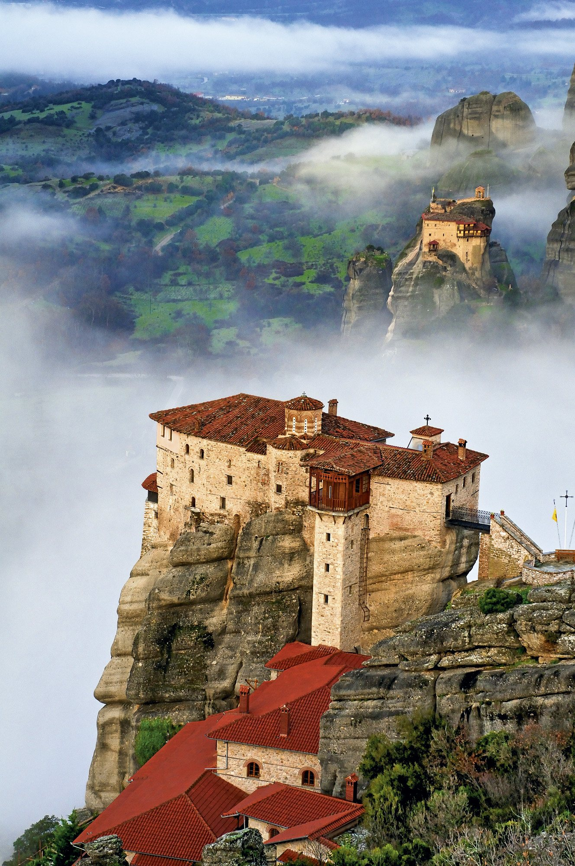
GREECE

