Slide 1
Portugal
Portugal, which has a population of 10 million, is located on the Iberian Peninsula and forms the southwestern edge of Europe. It borders with Spain and the Atlantic Ocean. Portugal also includes two groups of islands, the Azores and Madeira. The northwest area of Portugal is hilly and rainy while the northeast is mountainous and drier. The south is characterized by low plains and hills. Portugal was settled by humans more than 7,000 years ago. The Portuguese played an important role in the Age of Discovery, with sailors exploring Africa and the Americas. The Mediterranean climate of Portugal is similar to San Diego, California.

Slide 2
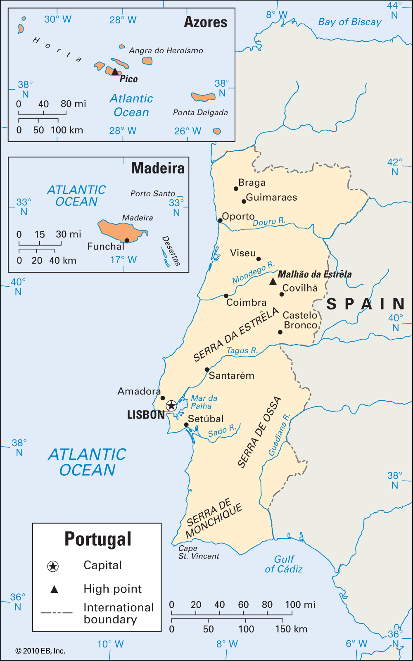
Portugal

Slide 3
Portugal
OFFICIAL NAME: Portuguese Republic
FORM OF GOVERNMENT: Republic, parliamentary democracy
CAPITAL: Lisbon
POPULATION: 10,813,834
OFFICIAL LANGUAGES: Portuguese, Mirandese
MONEY: Euro
AREA: 35,516 square miles (91,985 square kilometers)

Slide 4
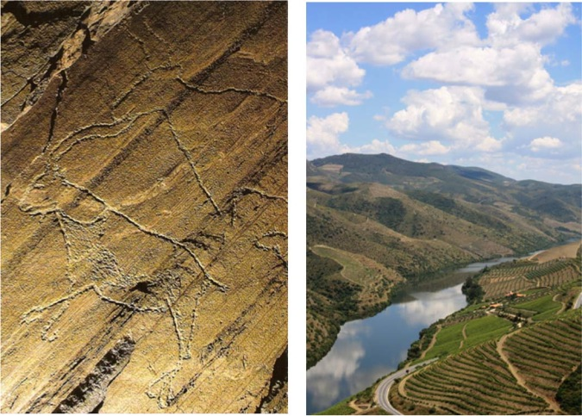
Portugal

